Slide 1
Topics:
Introduction to regression
Introduction to classification
What is Linear regression
What is Logistic regression
Logistic vs Linear

Slide 2
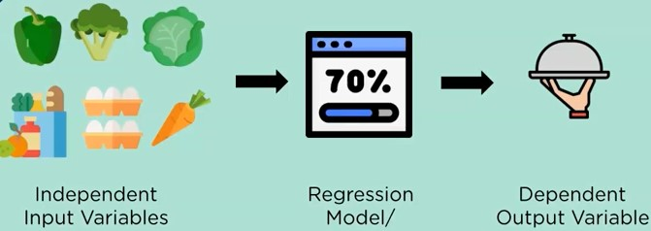
Introduction to regression
Regression is a statistical method which allows us to predict a dependent output variable based on the values of independent input variables.

Slide 3
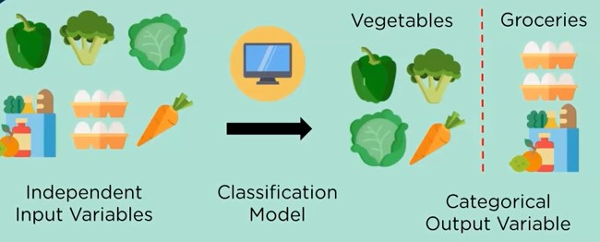
Introduction to classification
Classification allows us to divide a given input into some predefined categories.the output is a discrete value like 0/1 ,True/False or a predefined output label class.

Slide 4
What is Linear regression?
Linear regression is a machine learning model that is used to predict the values of output variables based on the values of input variables.

Slide 5
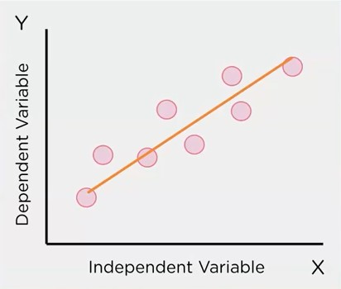
The input variables,x are called independent variable and are used to predict the values of response variable.
The output variable y,is called the dependant variable.its value depends on the value of x.
Linear regression aims to find the relationship between input and output variables by ploting a line which fits the data given to it.

Slide 6
The equation which can be used to fit a line is the equation of a straight line.
The equation gives the output variables based on the input Variable and inclination of the line.
Y = b₀+ b₁X
Output
Y-intercept
slope
Feature/input

Slide 7
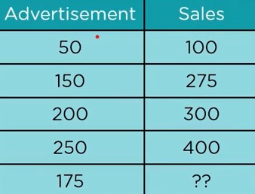
The data given represents the amount a company puts into advertisement and the resulting sales in thousands.using regression,given the advertisement amount ,we can predict the how many sales will take place

Slide 8
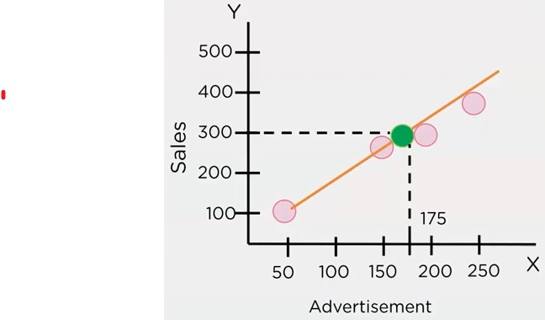
With the help of Linear regression,we can plot the graph of sales vs advertisememt and find the line of best fit between them and using that to find the variables of the missing values

